Slide 1
EE 735 (Microelectronics Simulation Lab)
Assignment -3
(23rd August 2023)
Instructor: Prof. Saurabh Lodha
TA : Chenna Satya Sai Teja
Ph no: 7076315403
Mail: 22m1132@iitb.ac.in

Slide 2
Question 1
P-N junction diode (see Figure 1:(a)). Thickness of the P and N regions is L = 1.5 μm each. For the following doping profiles, plot profiles 1-3 (from introduction section) with and without depletion approximation and plot profiles 4-5(from introduction section) without depletion approximation
Abrupt junction (see Figure 1:(b)) with dopant concentrations N_{A} = (1+a)10¹⁵/cm3 N_{D} = (1+b)10¹⁵/cm3.
Linearly graded junction (see Figure 1:(c)) with bulk dopant concentrations NA = ND = (1+b)10¹⁵/cm3

Slide 3
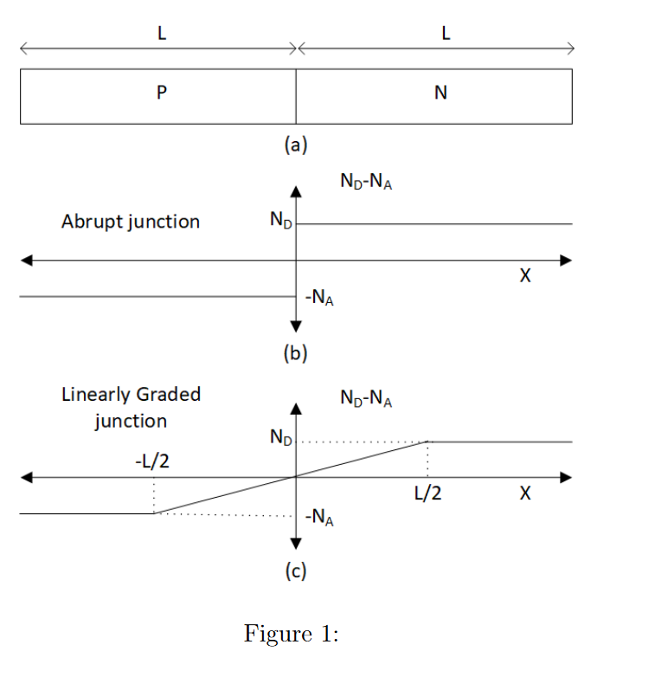
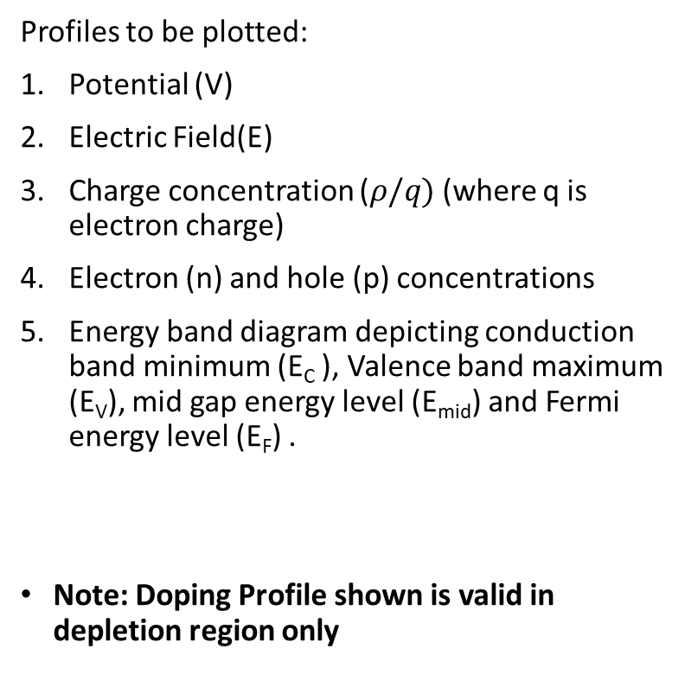
Question 1 (cont.)
Profiles to be plotted:
Potential (V)
Electric Field(E)
Charge concentration ($ρ/q)$(where q is electron charge)
Electron (n) and hole (p) concentrations
Energy band diagram depicting conduction band minimum (E_{C} ), Valence band maximum (E_{V}), mid gap energy level (E_{mid}) and Fermi energy level (E_{F}) .
Note: Doping Profile shown is valid in depletion region only

Slide 4
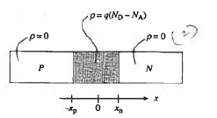
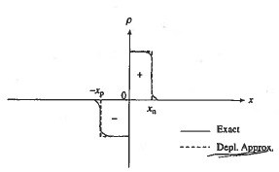
Depletion Approximation vs Exact Analysis
The approximation has two components that can be stated as follows:
The Carrier concentrations are assumed to negligible compared to the net doping concentration in a region –xp < x < xn.
The charge density outside the depletion region is taken to be identically zero.

Slide 5


Depletion Approximation vs Exact Analysis (cont.)
With Depletion approximation
$ρ=q(N_{D}−N_{A})$
$$\frac{d^{2}V}{dx^{2}}=−\frac{ρ}{ε}$$
Without Depletion approximation
$ρ=q\left(p−n+N_{D}−N_{A}\right)$
$$\frac{d^{2}V}{dx^{2}}=−\frac{ρ}{ε}$$

Slide 6
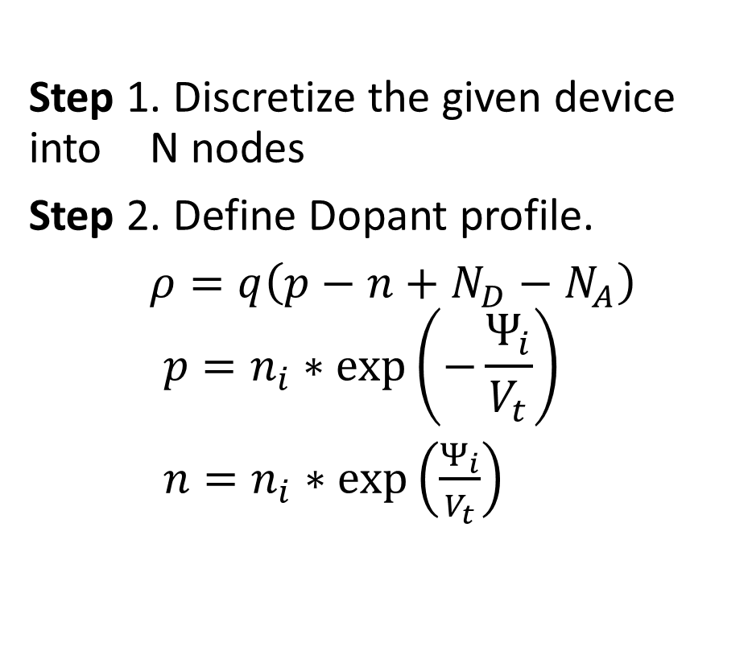
Solving Poisson Equation
Step 1. Discretize the given device into N nodes
Step 2. Define Dopant profile.
$ρ=q\left(p−n+N_{D}−N_{A}\right)$
$$p=n_{i}∗\exp\left(−\frac{Ψ_{i}}{V_{t}}\right)$$
$n=n_{i}∗\exp\left(\frac{Ψ_{i}}{V_{t}}\right)$

Slide 7
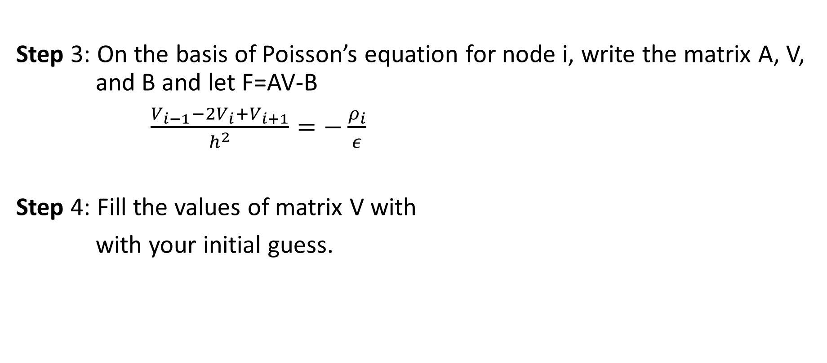
Solving Poisson Equation
Step 3: On the basis of Poisson’s equation for node i, write the matrix A, V, and B and let F=AV-B
$\frac{V_{i−1}−2V_{i}+V_{i+1}}{h^{2}}=−\frac{ρ_{i}}{ε}$
Step 4: Fill the values of matrix V with
with your initial guess.

Slide 8
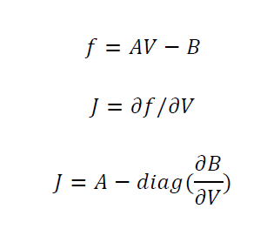
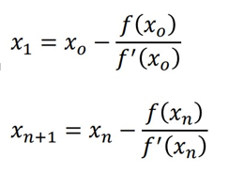
Solving Poisson Equation
Step 5: Create Jacobian Matrix (J) and solve using newton Raphson method.
Newton Raphson Method

Slide 9

Solving Poisson Equation
Step 6: Obtain a solution for ΔV as Δ𝑉=−$J^{−1}f$(You can write “J\f” to obtain in matlab)

Slide 10
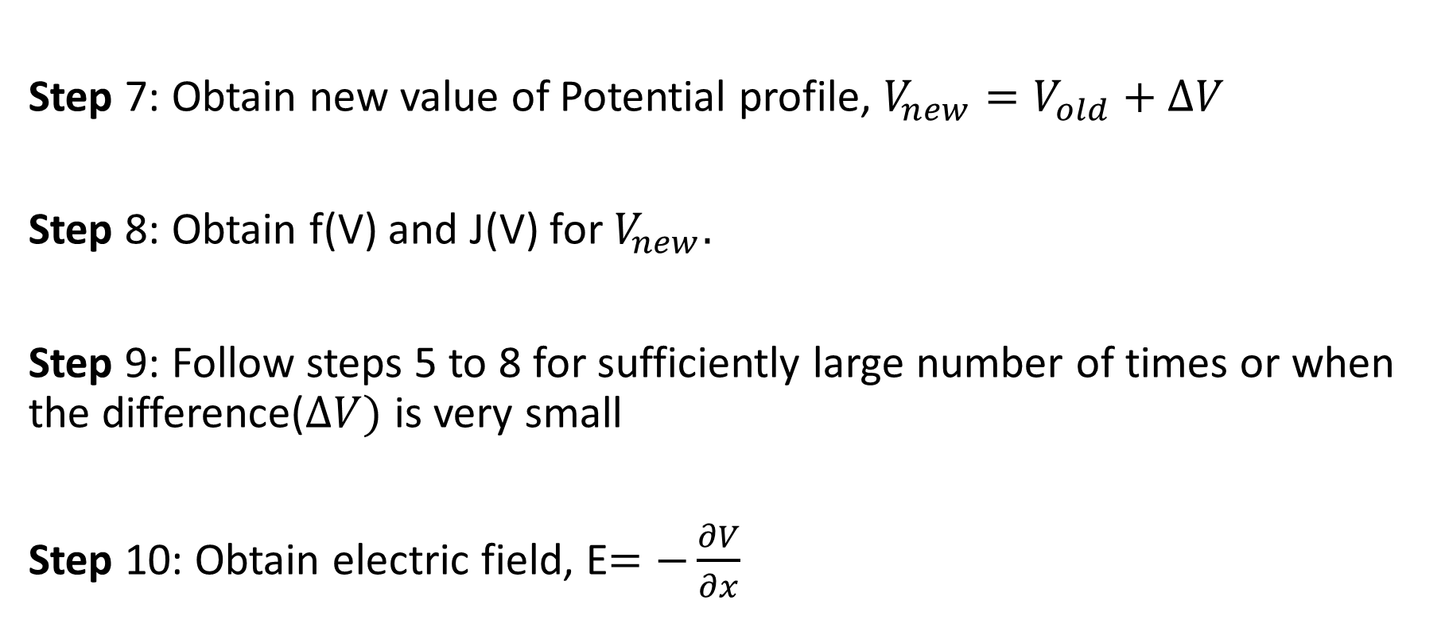
Solving Poisson Equation
Step 7: Obtain new value of Potential profile, $V_{new}=V_{old}+ΔV$
Step 8: Obtain f(V) and J(V) for $V_{new}.$
Step 9: Follow steps 5 to 8 for sufficiently large number of times or when the difference($ΔV)$ is very small
Step 10: Obtain electric field, E$=−\frac{∂V}{∂x}$

Slide 11

Solving Poisson Equation
Step 11: Plot Energy band diagram wrt Ef
$E_{fi}−E_{f}=V_{t}∗log⁡(\frac{p}{n_{i}})$
$E_{c}=E_{fi}+\frac{E_{g}}{2}$
$E_{v}=E_{fi}−\frac{E_{g}}{2}$

Slide 12
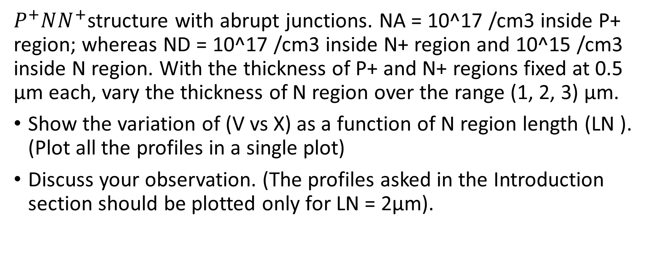
Question 2
$P^{+}NN^{+}$structure with abrupt junctions. NA = 10^17 /cm3 inside P+ region; whereas ND = 10^17 /cm3 inside N+ region and 10^15 /cm3 inside N region. With the thickness of P+ and N+ regions fixed at 0.5 μm each, vary the thickness of N region over the range (1, 2, 3) μm.
Show the variation of (V vs X) as a function of N region length (LN ). (Plot all the profiles in a single plot)
Discuss your observation. (The profiles asked in the Introduction section should be plotted only for LN = 2μm).

Slide 13
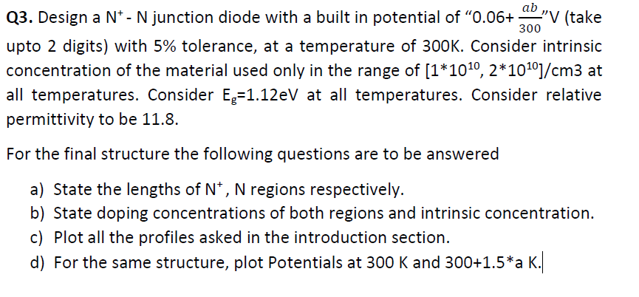
Question 3

Slide 14
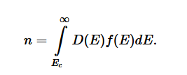
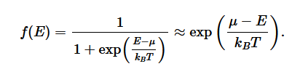
Boltzmann Approximation
Boltzmann approximation assumes that the Fermi energy is at least 3kT from the band edges.

Slide 15
Reference
Section 5.1 from “Semiconductor Device Fundamentals” by Robert F Pierret for “Depletion Approximation”.
Section 4.4 from “Advanced Semiconductor Fundamentals” by Robert F Pierret for “Boltzmann Approximations and other formulas used for finding n and p concentrations”

Slide 16
Thank you..

